Slide 1
如何让EBSCO成为您的学术好帮手?
---休闲观光及饭店餐饮管理全文数据库
Sophia Jiang
Senior Training Manager, EBSCO

Slide 2


EBSCO was founded by
Elton B. Stephens in 1944
70 years serving the information needs of institutions
5,700 employees
1,100+ employees outside the U.S

Slide 3

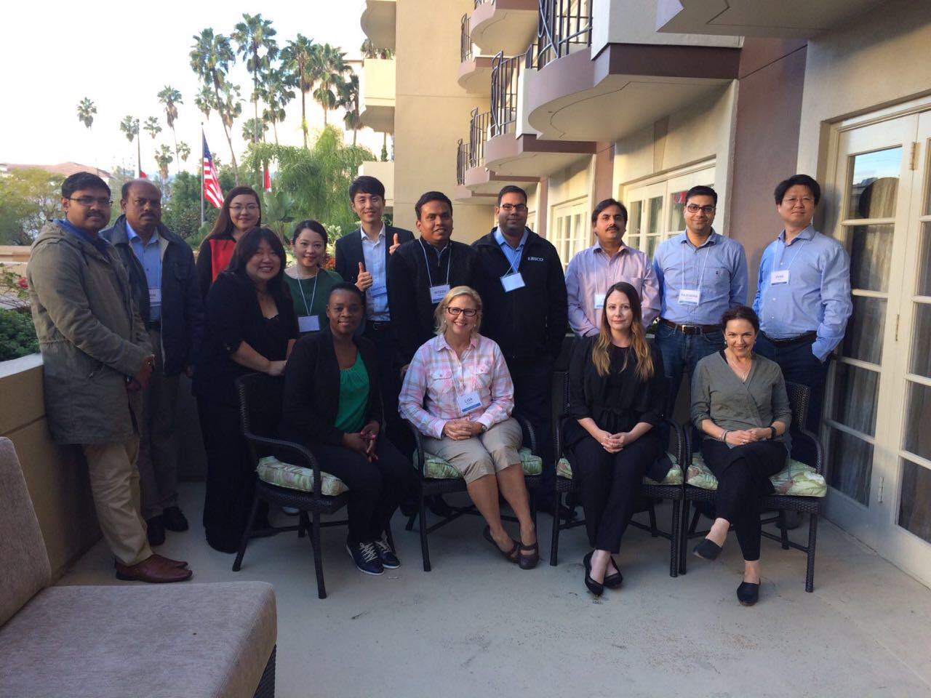
H.Q. based in Boston

Slide 4
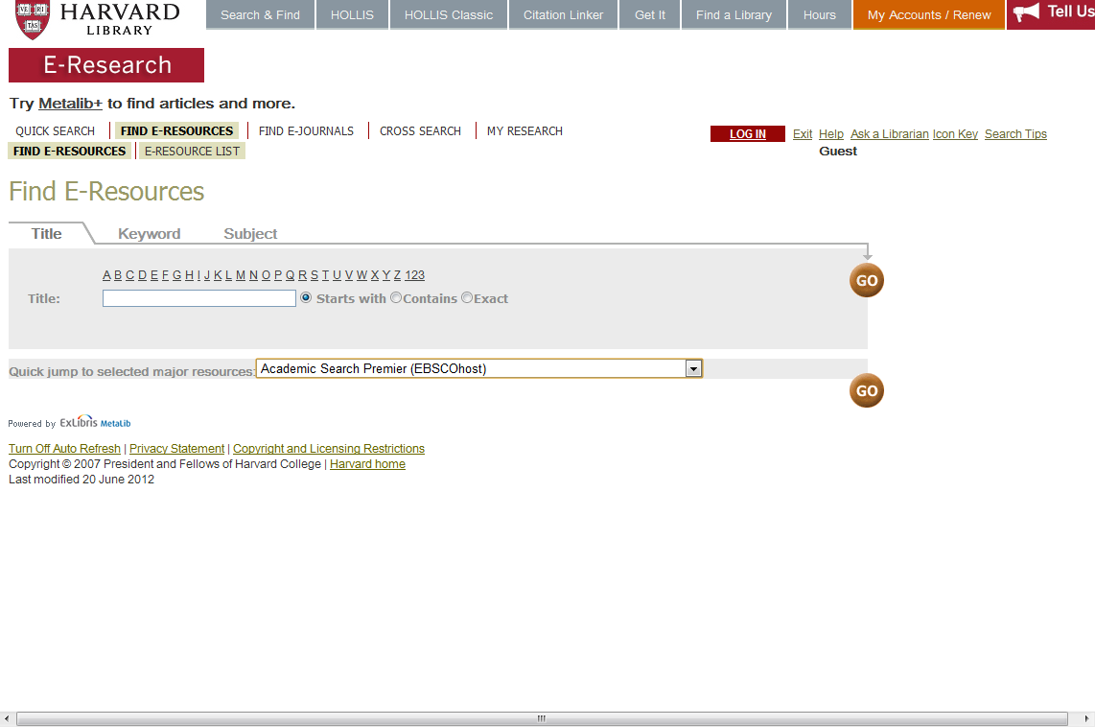
哈佛大学图书馆
Quick jump to selected major resources
预设”主要资源” EBSCO Academic Search

Slide 5
耶鲁大学图书馆
EBSCO Academic Search为耶鲁图书馆推荐数据库

Slide 6
(Elton B. Stephens COmpany)
EBSCO简介
EBSCO是目前世界上最大的提供学术文献服务的专业公司之一，提供数据库，期刊、文献订购及出版等服务，总部在美国，在全球22个国家设有办事处。开发了300多个在线文献数据库产品，涉及自然科学、社会科学、生物医学、人文艺术等多学科领域。
EBSCO数据库是在中国大陆地区有近600家高校订户，北京大学、清华大学、上海交通大学、西安交通大学、北京交通大学、复旦大学、中国人民大学、中国科学院、中国社科院、中国国家图书馆，上海图书馆，浙江图书馆、天津图书馆均为EBSCO数据库的用户。

Slide 7
课程内容
第一部分： 数据库内容介绍Introduction of Database Content
第二部分： 上机操作演示 Demonstration
案例检索：如何查找顶尖的旅游管理及酒店管理科研论文
如何查询学科顶尖期刊投稿指南，订阅期刊通报
文件夹的建立与利用，批量管理文献导出
第三部分：在线帮助及参与网络课程Q&A

Slide 8
第一部分： 数据库内容介绍
Introduction of Database Content

Slide 9

Make-Up of Hospitality & Tourism Complete
Hospitality &
Tourism Complete
All indexing & abstracts from HTI
5 conference
proceedings collections
256 full-text journals
& magazines including
Hotel Management, International Journal of Tourism Research, Lodging Hospitality, Restaurant Business, Restaurant Hospitality, Tourism & Hospitality Management, etc.
57 full-text
books & monographs including The Encyclopedia
of Tourism
Also includes market research reports on restaurants & foodservice and travel & tourism
Hospitality & Tourism Complete

Slide 10
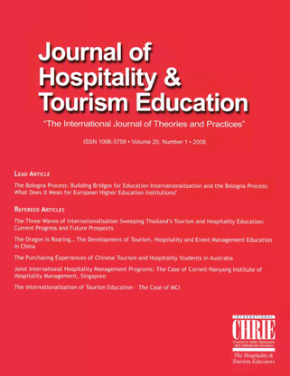
Hospitality & Tourism Complete
Contains the Journal of Hospitality
& Tourism Education
Hospitality &
Tourism Complete
The #1 hospitality & tourism
education journal
An award-winning, refereed, interdisciplinary quarterly journal
Full text from 2005 to present
Not available in full text in other EBSCOhost database
Not available with active full text in databases from other vendors
Hospitality & Tourism Complete

Slide 11

Hospitality & Tourism Complete
Contains Hosteur
Hospitality &
Tourism Complete
The #1 international publication for student transition from undergraduate education to graduate- or study-abroad programs, professional life with restaurants and foodservice management, hotels and lodging; travel-related businesses; food & beverage suppliers; equipment manufacturers; trade and professional associations; and commodity groups
Full text with NO embargo
Hospitality & Tourism Complete

Slide 12
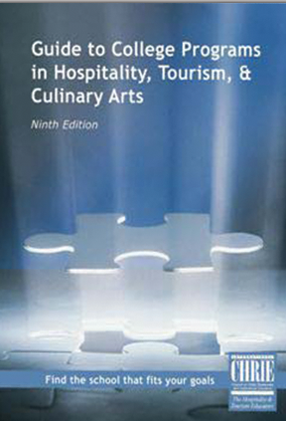
Hospitality & Tourism Complete
Contains the Guide to College Programs in Hospitality, Tourism & Culinary Arts, Ninth Edition
Hospitality &
Tourism Complete
The only complete guide to accredited
programs in hospitality and tourism
An essential resource for prospective students and industry employees seeking advancement through education, career counselors, corporate recruiters and industry organizations
This publication provides listings by specialization and geographic location detailing educational opportunities available at two-year, four-year, and graduate-level hospitality and tourism programs in North America and abroad
Each detailed listing in the Guide covers the “vital statistics” of each program – student enrollment, program features, accreditation, admission and graduation requirements, and financial aid sources. The Guide to College Programs also offers a wealth of scholarship information
Hospitality & Tourism Complete

Slide 13
第二部分： 上机操作演示
1.案例检索：如何查找顶尖的旅游管理及酒店管理科研论文
2.如何查询学科顶尖期刊投稿指南，订阅期刊通报
3.文件夹的建立与利用，批量管理文献导出

Slide 14
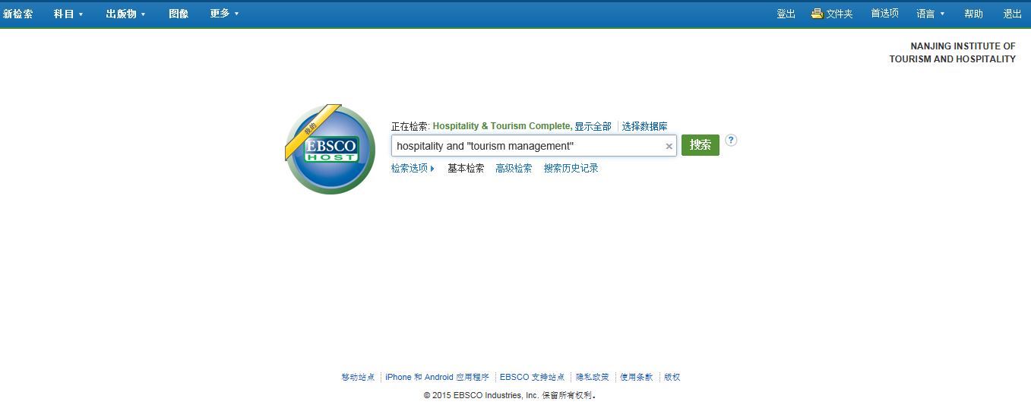


利用关键词或者固定短语进行基本检索

Slide 15
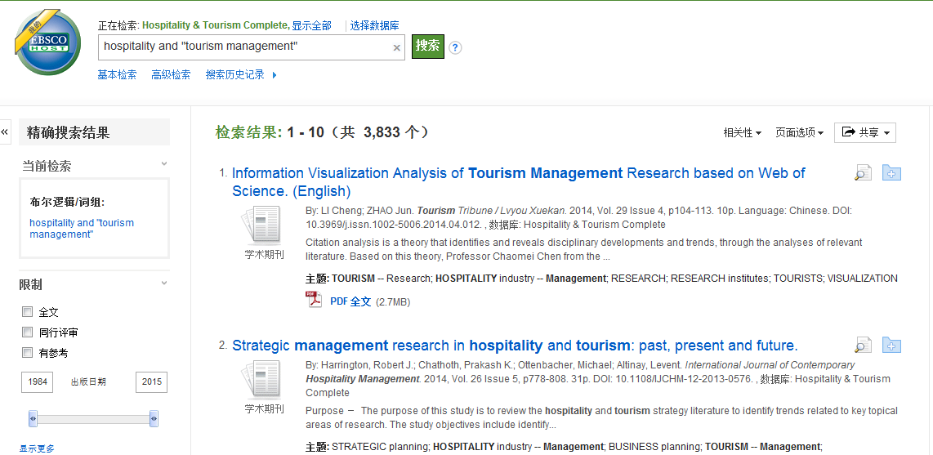


利用限制条件来缩小范围，精确搜索结果

Slide 16
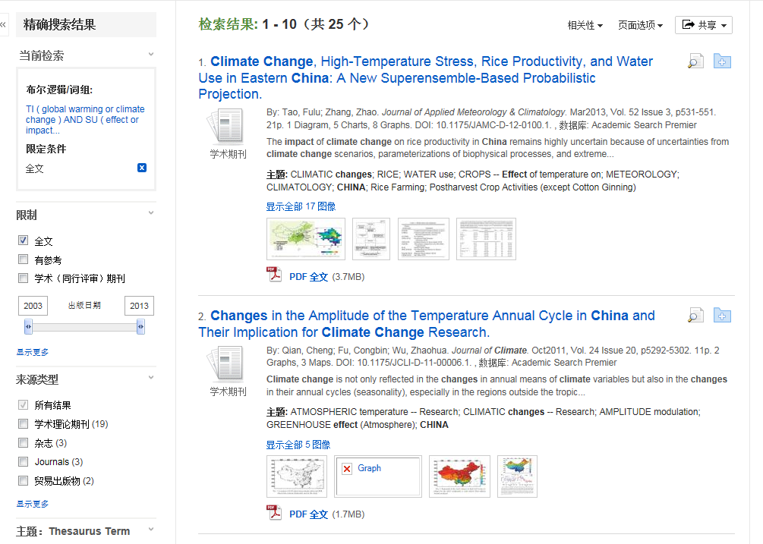


和基本检索一样可以通过限制条件来精确检索结果

Slide 17
检索技巧
短语检索（“”）
  “tourisim managment” 可以检索到固定格式的词组，位置顺序保持不变。
截词符号(*)
  Touri* 可以检索到tourist, tourism, etc
  Manag*可以检索到manage, managing, managed, managment, etc
通配符：适用于一个字母(?)
  organi?ation 可以检索到 organisation or organization
通配符：适用于多个字母(#)
  behavio#r will 可以检索到 behavior or behaviour

Slide 18
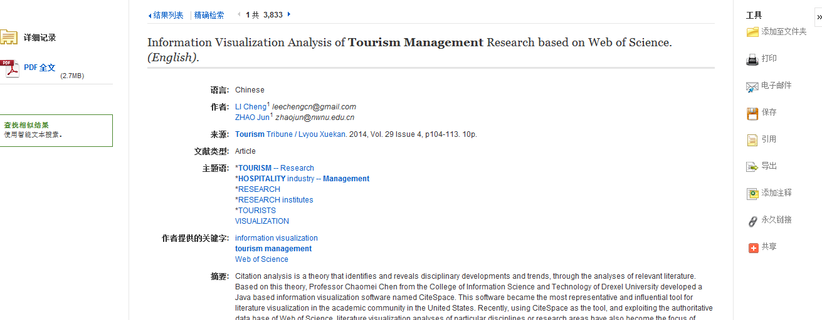


进入一篇文章查阅全文，利用右侧工具栏实现各个功能

Slide 19
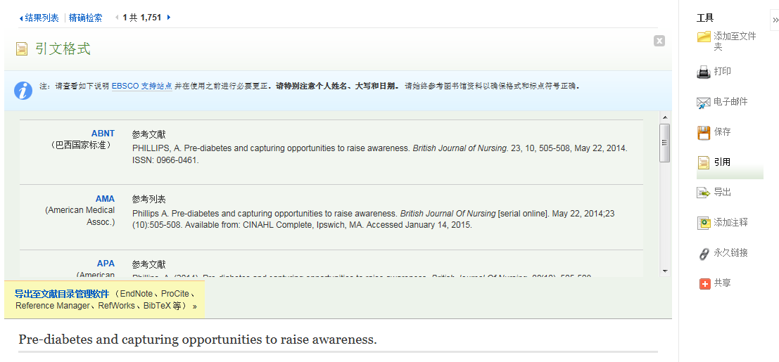
引用工具中有9中参考文献的格式，可以直接复制粘贴到文章后面的参考文献清单中，方便同学写论文时候管理参考文献。

Slide 20
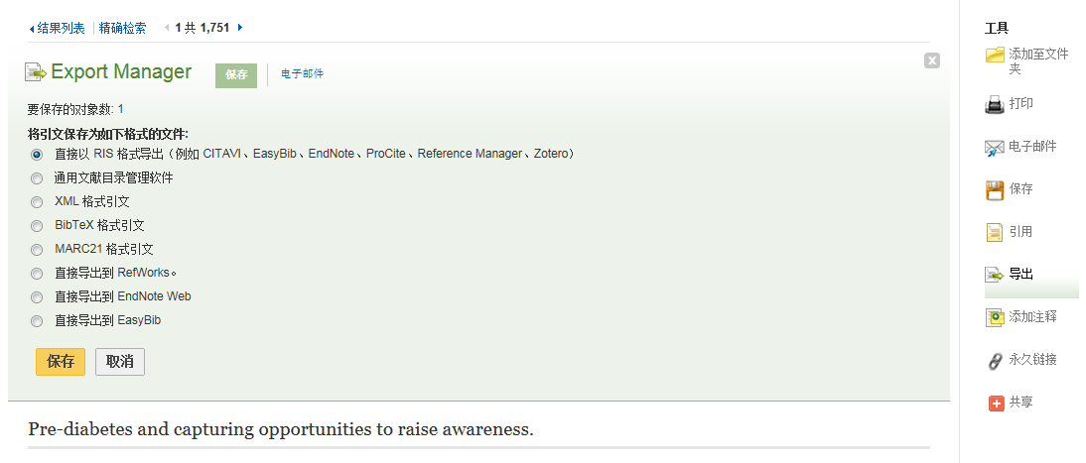
若9种格式无法满足需要，可选择导出工具，确认图书馆已购买的参考文献管理工具有哪些，然后选择相对应的栏目导出.

Slide 21
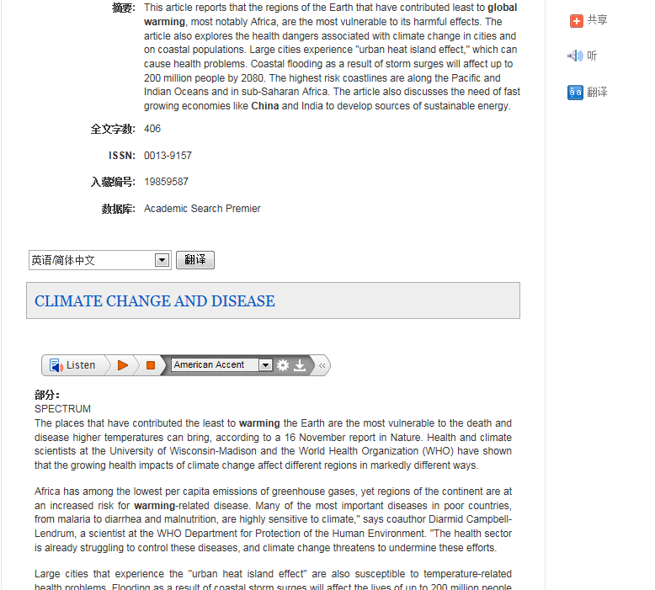


若该文章有HTML格式，可以实现翻译功能，并有朗读功能，可选择不同国家口音。

Slide 22
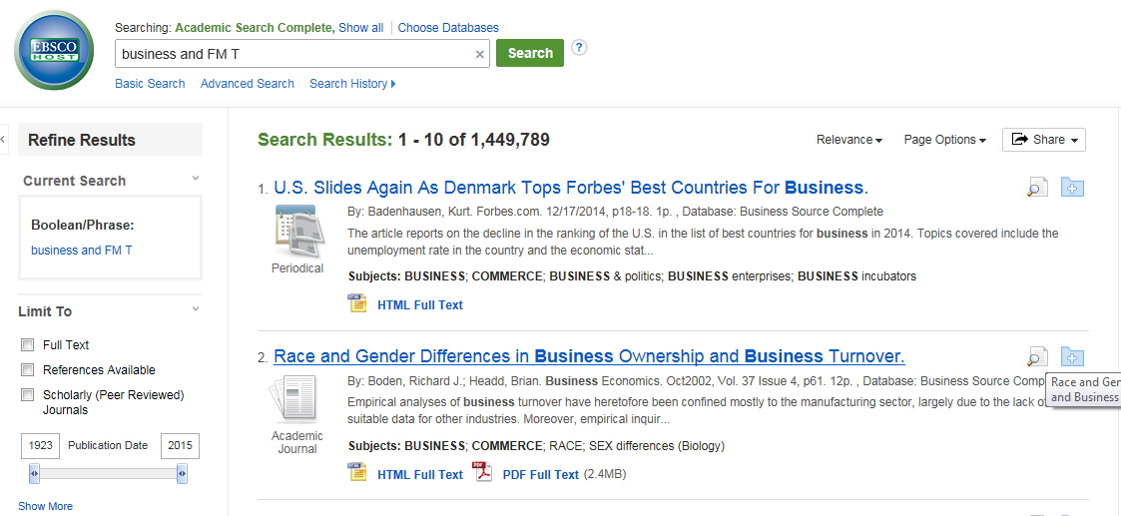
如何检索HTML格式带翻译和朗读的文献？
keyword and FM T
输入公式：keyword and FM T 可以检索到HTML格式文献，实现全文翻译及在线朗读功能，注意PDF文章无此功能。

Slide 23
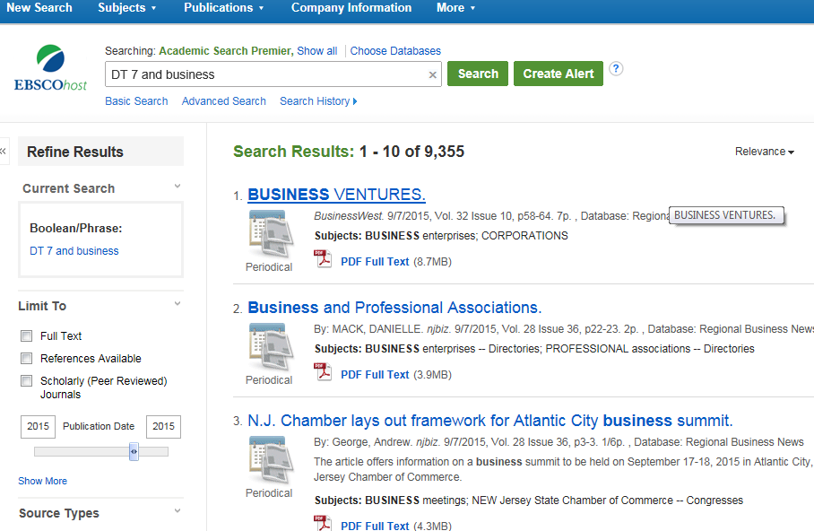
如何检索最近一周发表的文献？
DT 7 and keyword

Slide 24
第二小节
搜索顶尖英文期刊，
免费订阅酒店及旅游管理期刊
Create Alerts

Slide 25
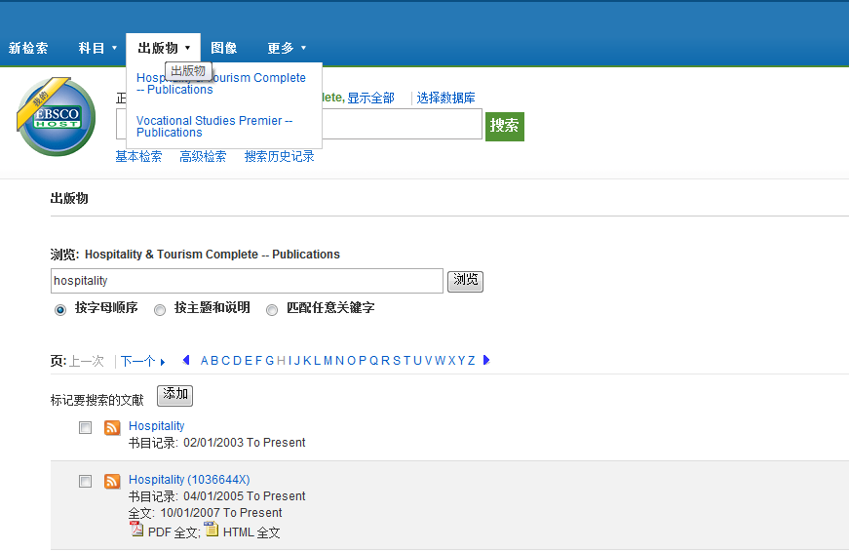


如何设定期刊新知通报Create Alerts

Slide 26
Hospitality & Tourism Complete
Contains the Journal of Hospitality
& Tourism Education
Hospitality &
Tourism Complete
The #1 hospitality & tourism
education journal
An award-winning, refereed, interdisciplinary quarterly journal
Full text from 2005 to present
Not available in full text in other EBSCOhost database
Not available with active full text in databases from other vendors
Hospitality & Tourism Complete

Slide 27
Hospitality & Tourism Complete
Contains Hosteur
Hospitality &
Tourism Complete
The #1 international publication for student transition from undergraduate education to graduate- or study-abroad programs, professional life with restaurants and foodservice management, hotels and lodging; travel-related businesses; food & beverage suppliers; equipment manufacturers; trade and professional associations; and commodity groups
Full text with NO embargo
Hospitality & Tourism Complete

Slide 28
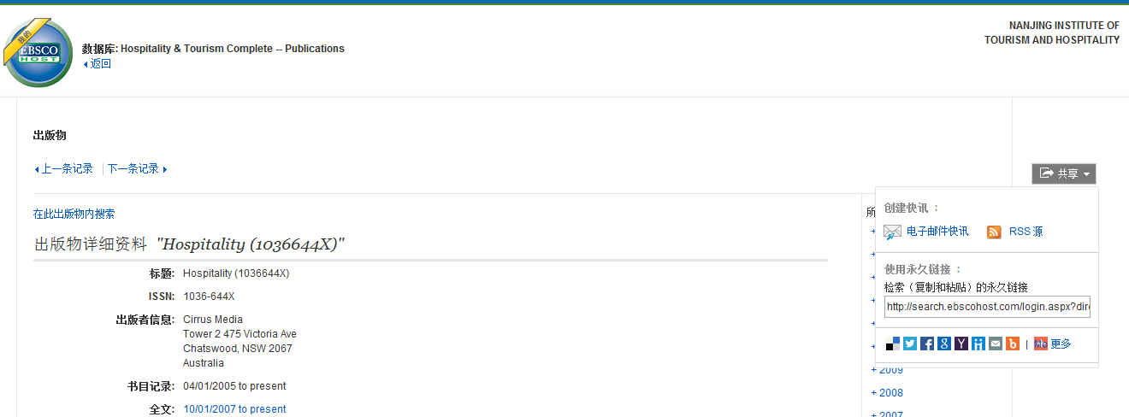

必须先登录我的My EBSCOhost，才能创建邮件快讯，通知更新的期刊内容

Slide 29
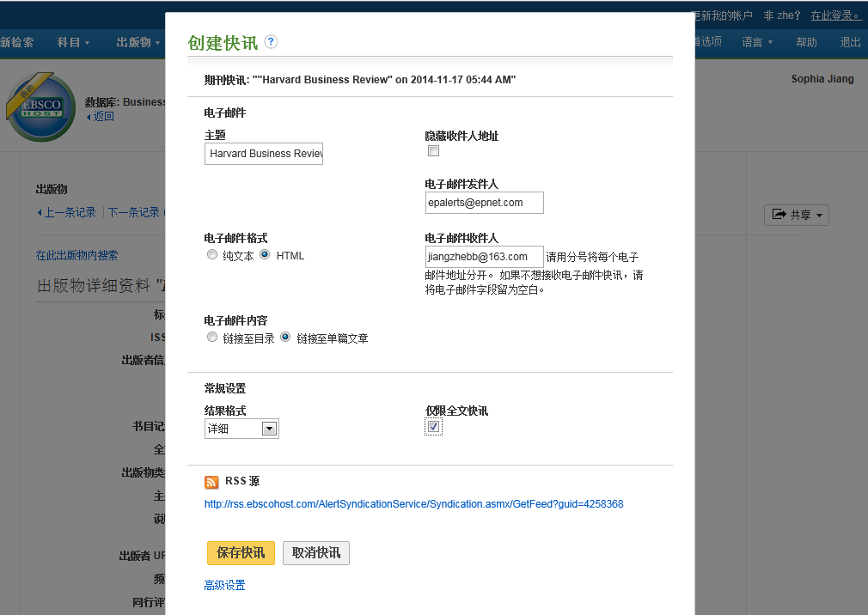

Slide 30
第三小节
文件夹的建立与利用
My EBSCO host Folder Account

Slide 31
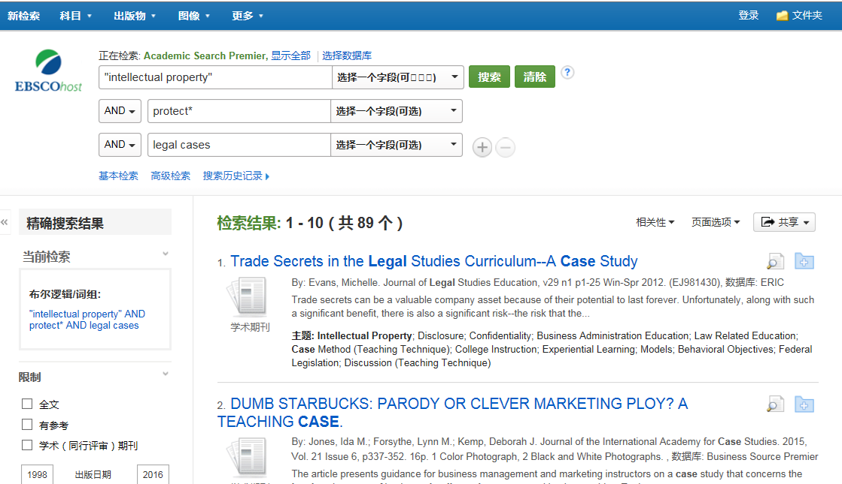


文件夹的建立与利用My EBSCO host Folder Account

Slide 32
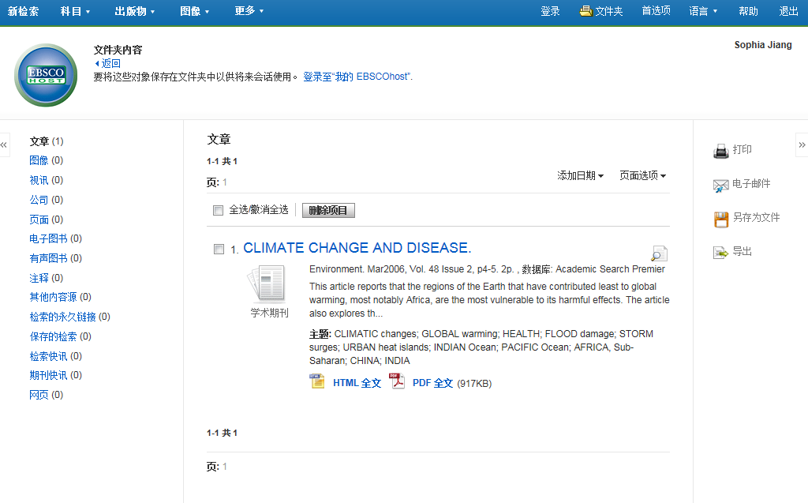




必须先创建我的EBSCOhost账号，并且登陆

Slide 33
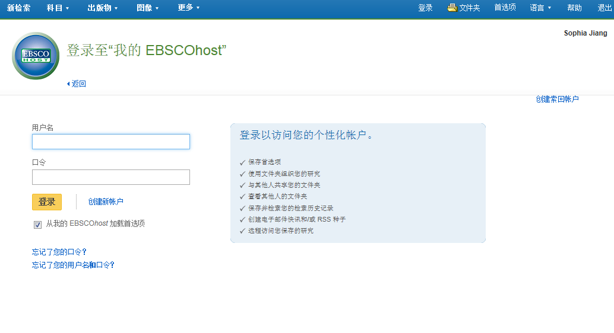


若之前没有账号，请先创建新账户

Slide 34
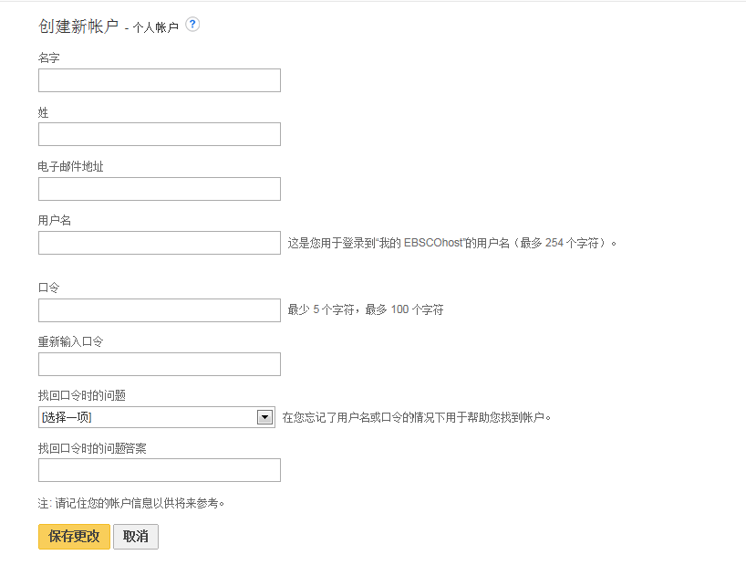

请注意用户名必须是唯一的，选择不易与其他人重复的，密码需要字母和数字组合。

Slide 35
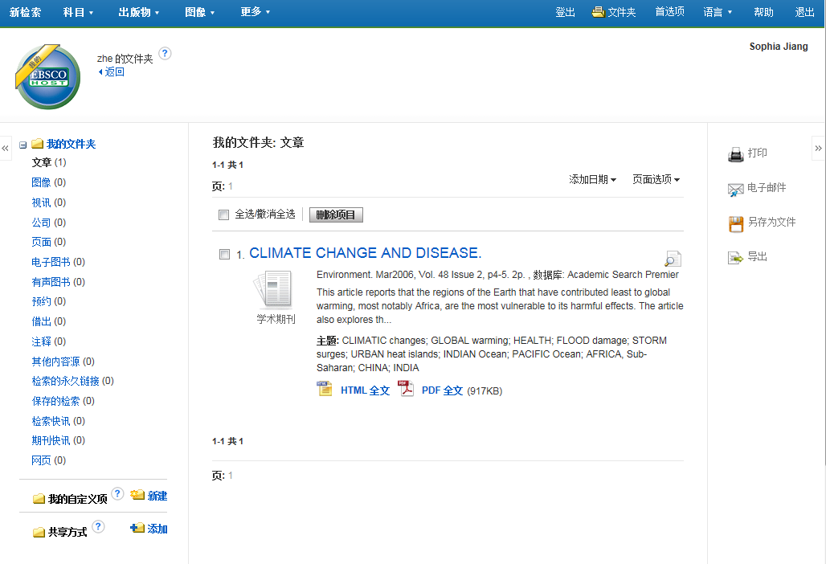



登录成功后图标会有一条黄色角标
可以新建文件夹，分类管理文献资料

Slide 36
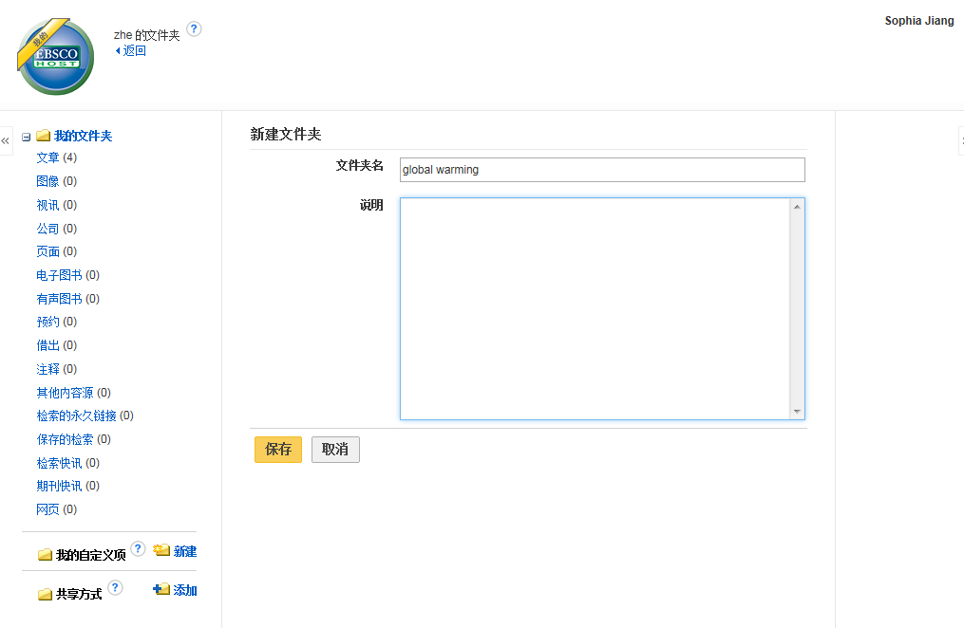


根据文献主题给文件夹命名

Slide 37
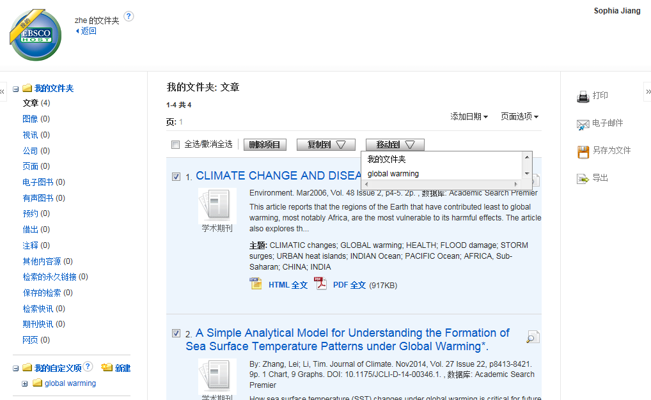


选择相应的文献资料，移动至新建的文件夹中, 在右侧工具栏中选中批量导出。

Slide 38
第四小节
EBSCO支持站点 https//:connect.ebsco.com

Slide 39
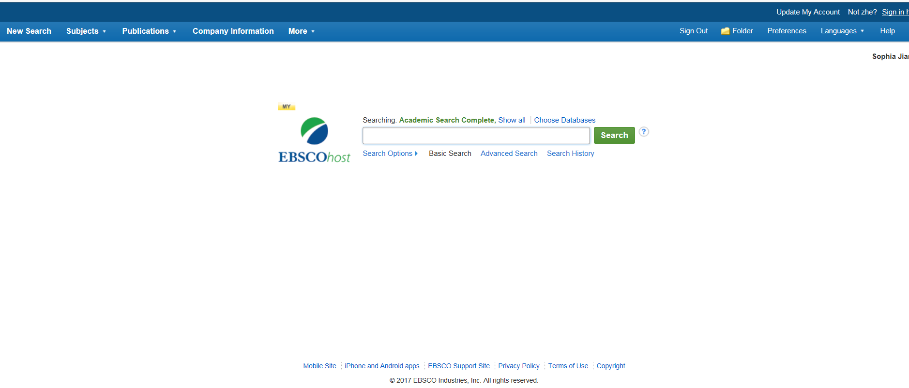

回到主页面，点击EBSCO支持站点，寻求在线帮助，下载PPT 或者观看视频.

Slide 40
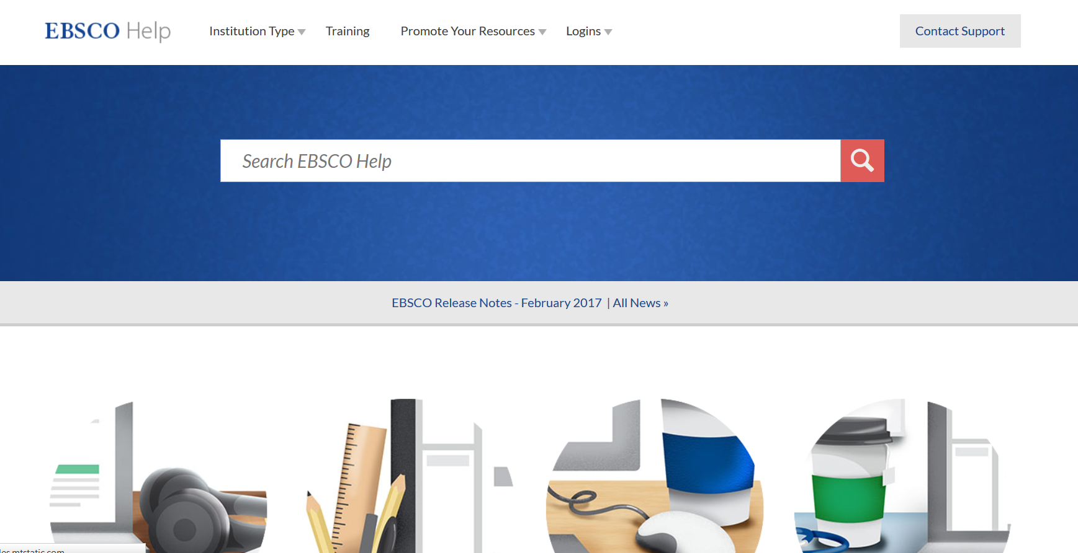

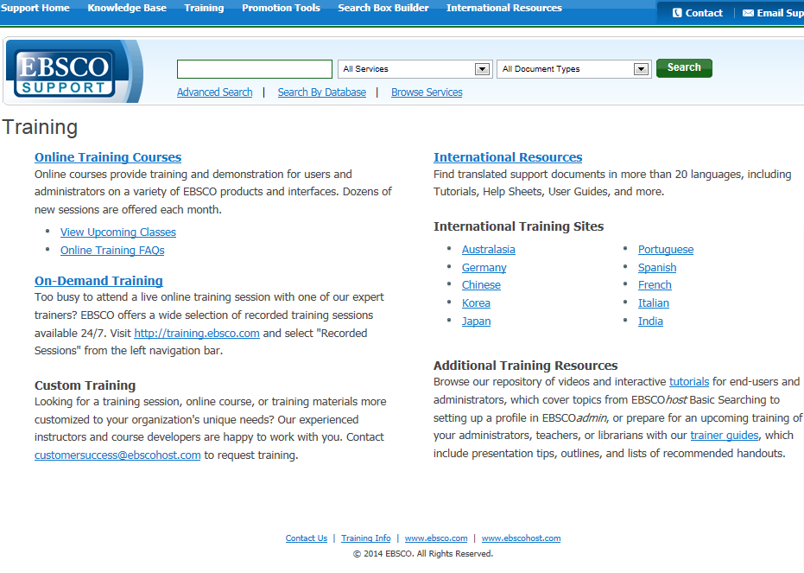
通过点击培训页面，进入training home, 然后选择右侧的中文培训资源即可。

Slide 41
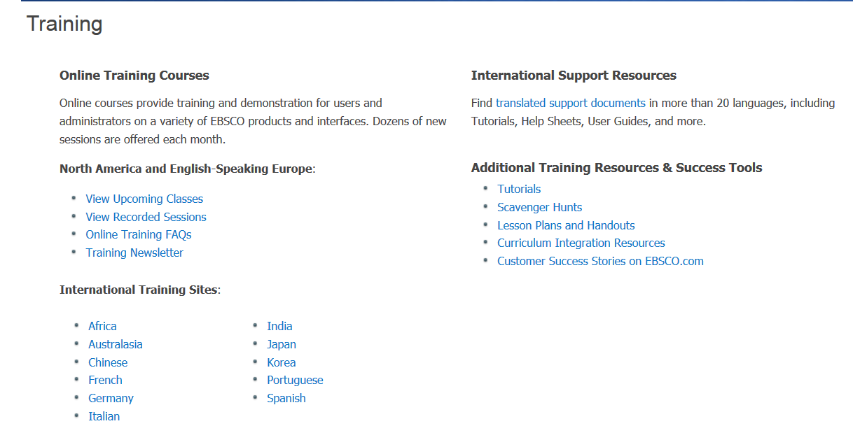
参加免费中文在线课程，或者下载PPT 或者观看视频

Slide 42
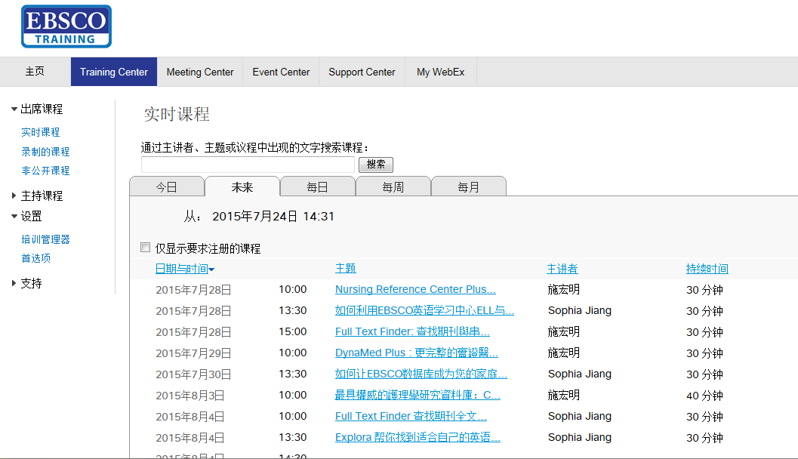

https://ebsco-chinese.webex.com/
你可以参加EBSCO网络课程，提前15分钟点击课程标题，加入课程。

Slide 43
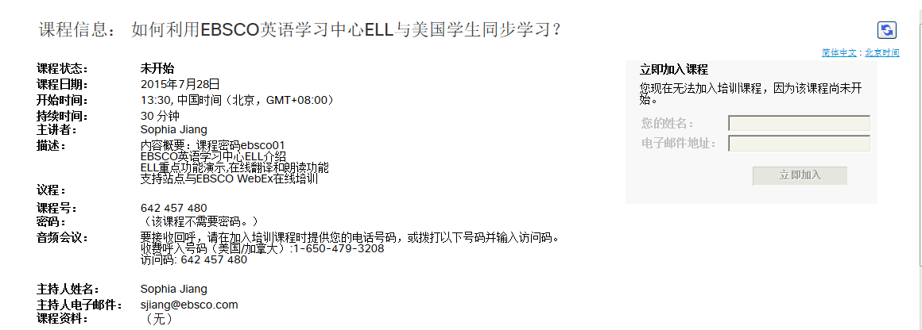

当字体变成黑色，输入姓名和邮箱即可开始上课。

Slide 44
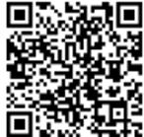
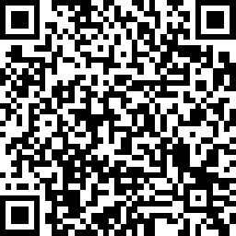
Thank You!
访问更多信息参见https://connect.ebsco.com/
Sophia Jiang sjiang@ebsco.com
EBSCO公众号
课程评价

